Slide 1


Smart Investment Recommendation Engine “WISEINVEST”

Slide 2
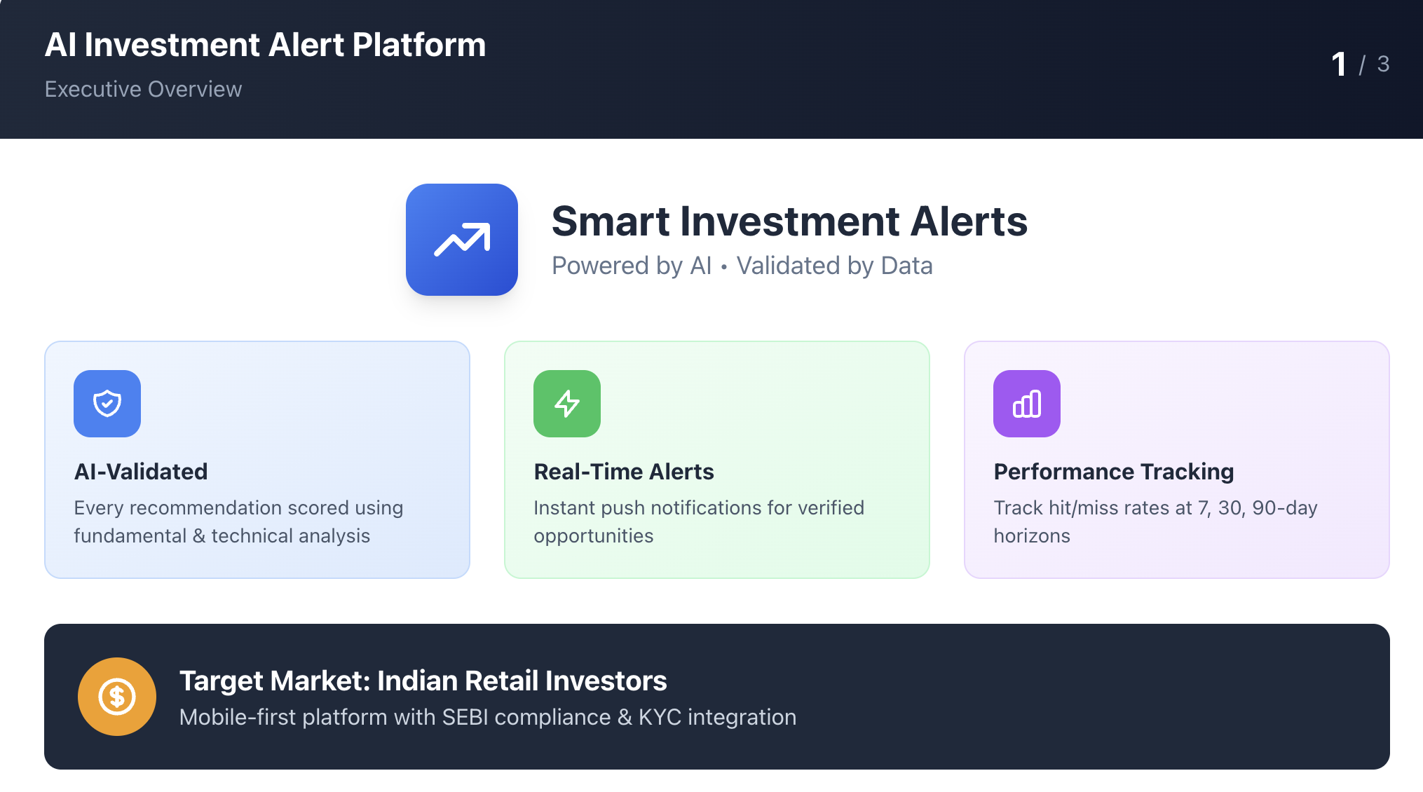

Slide 3
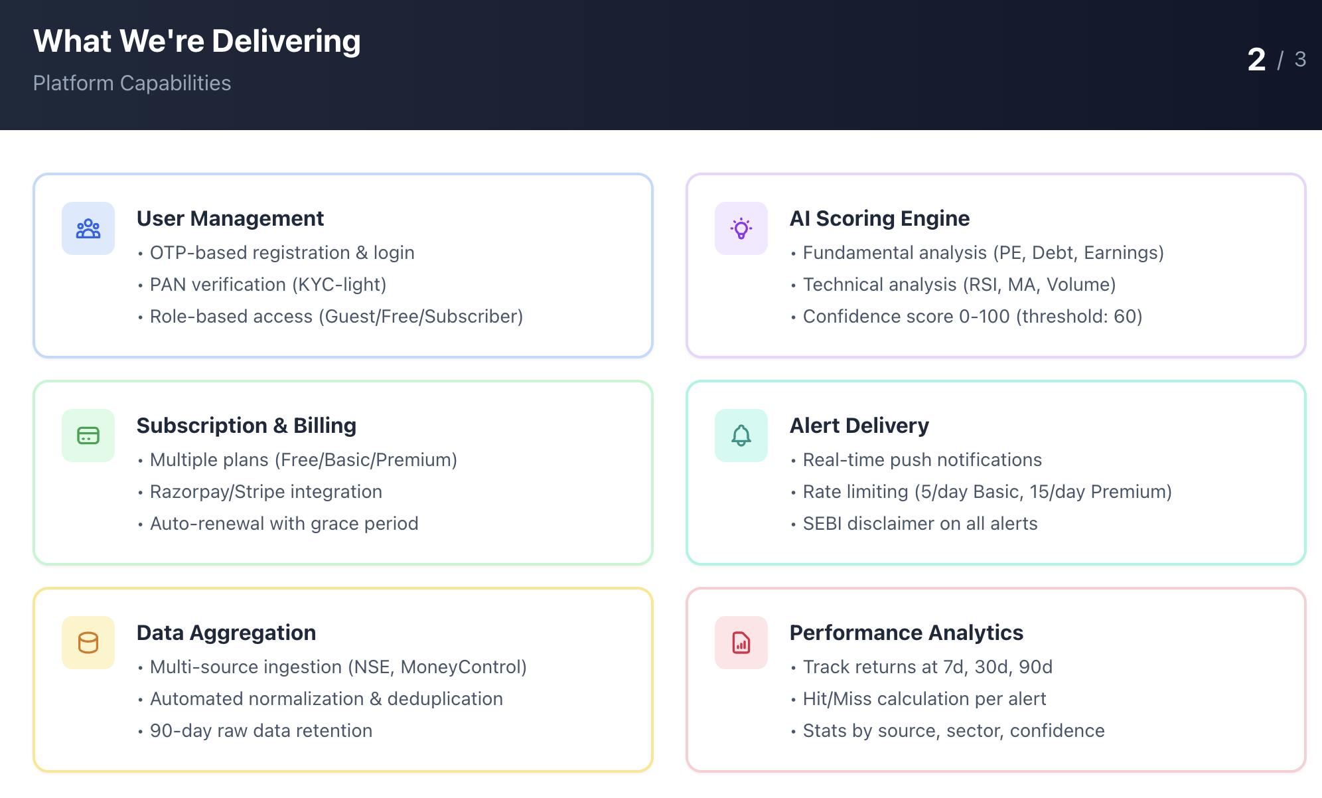

Slide 4
Functional Requirement

Slide 5
API Specifications
Document

Slide 6
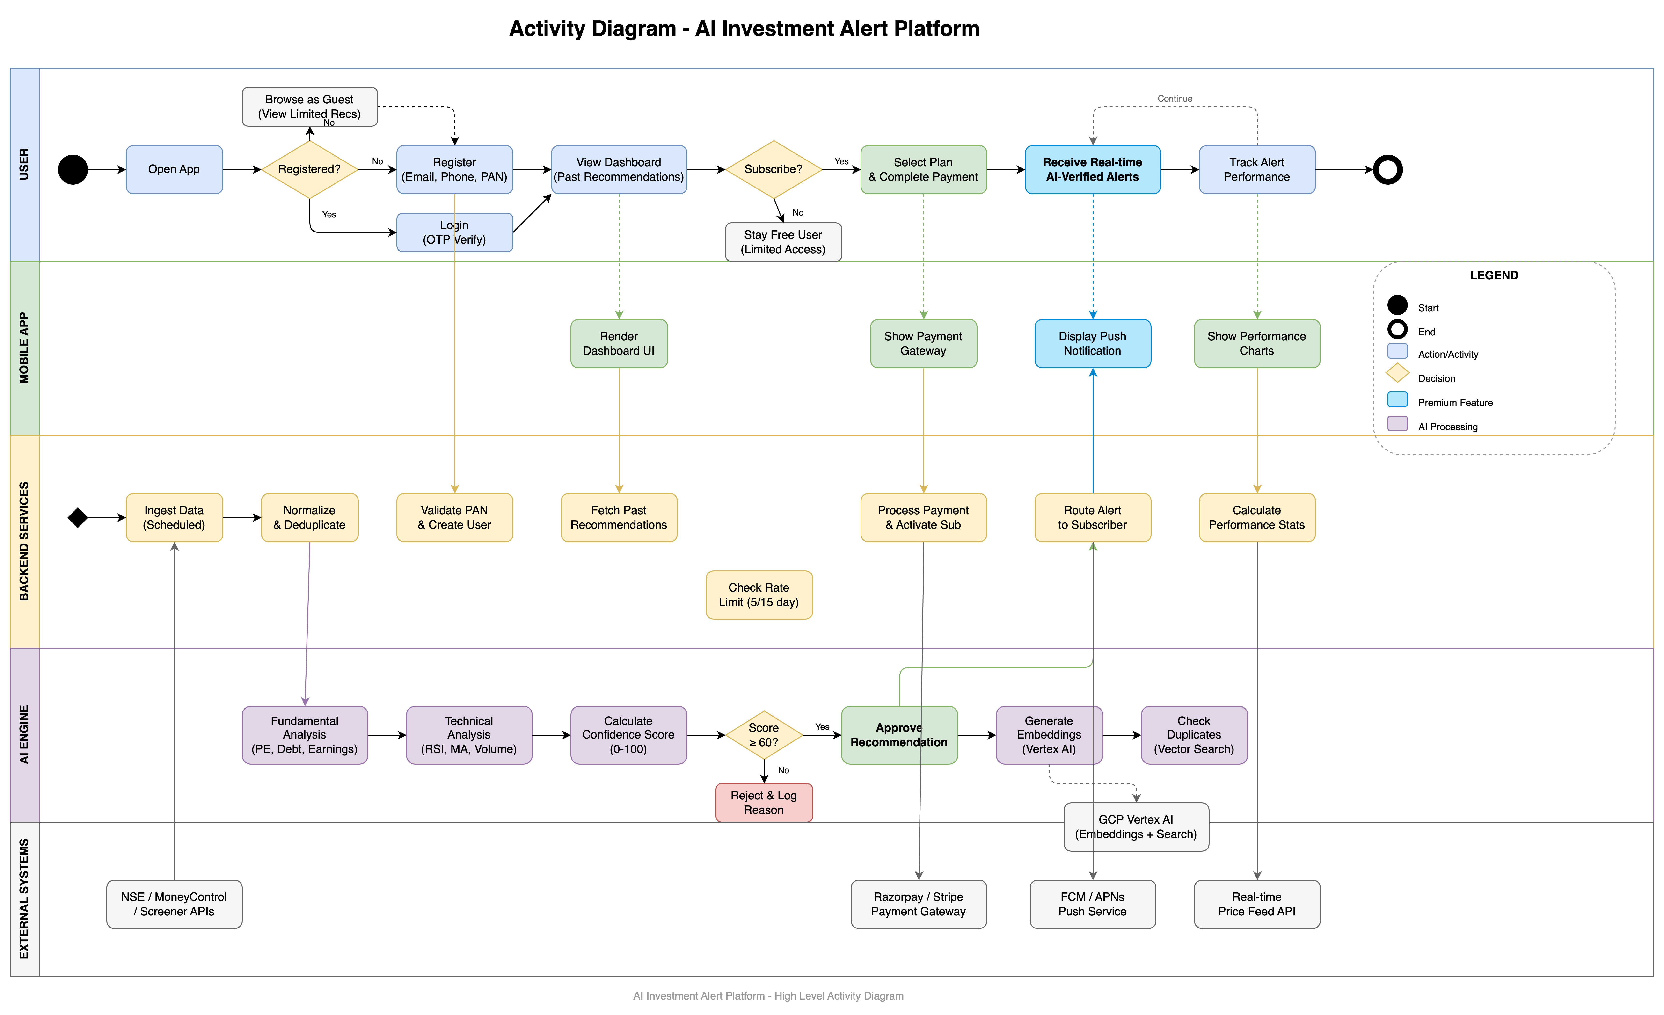

Slide 7
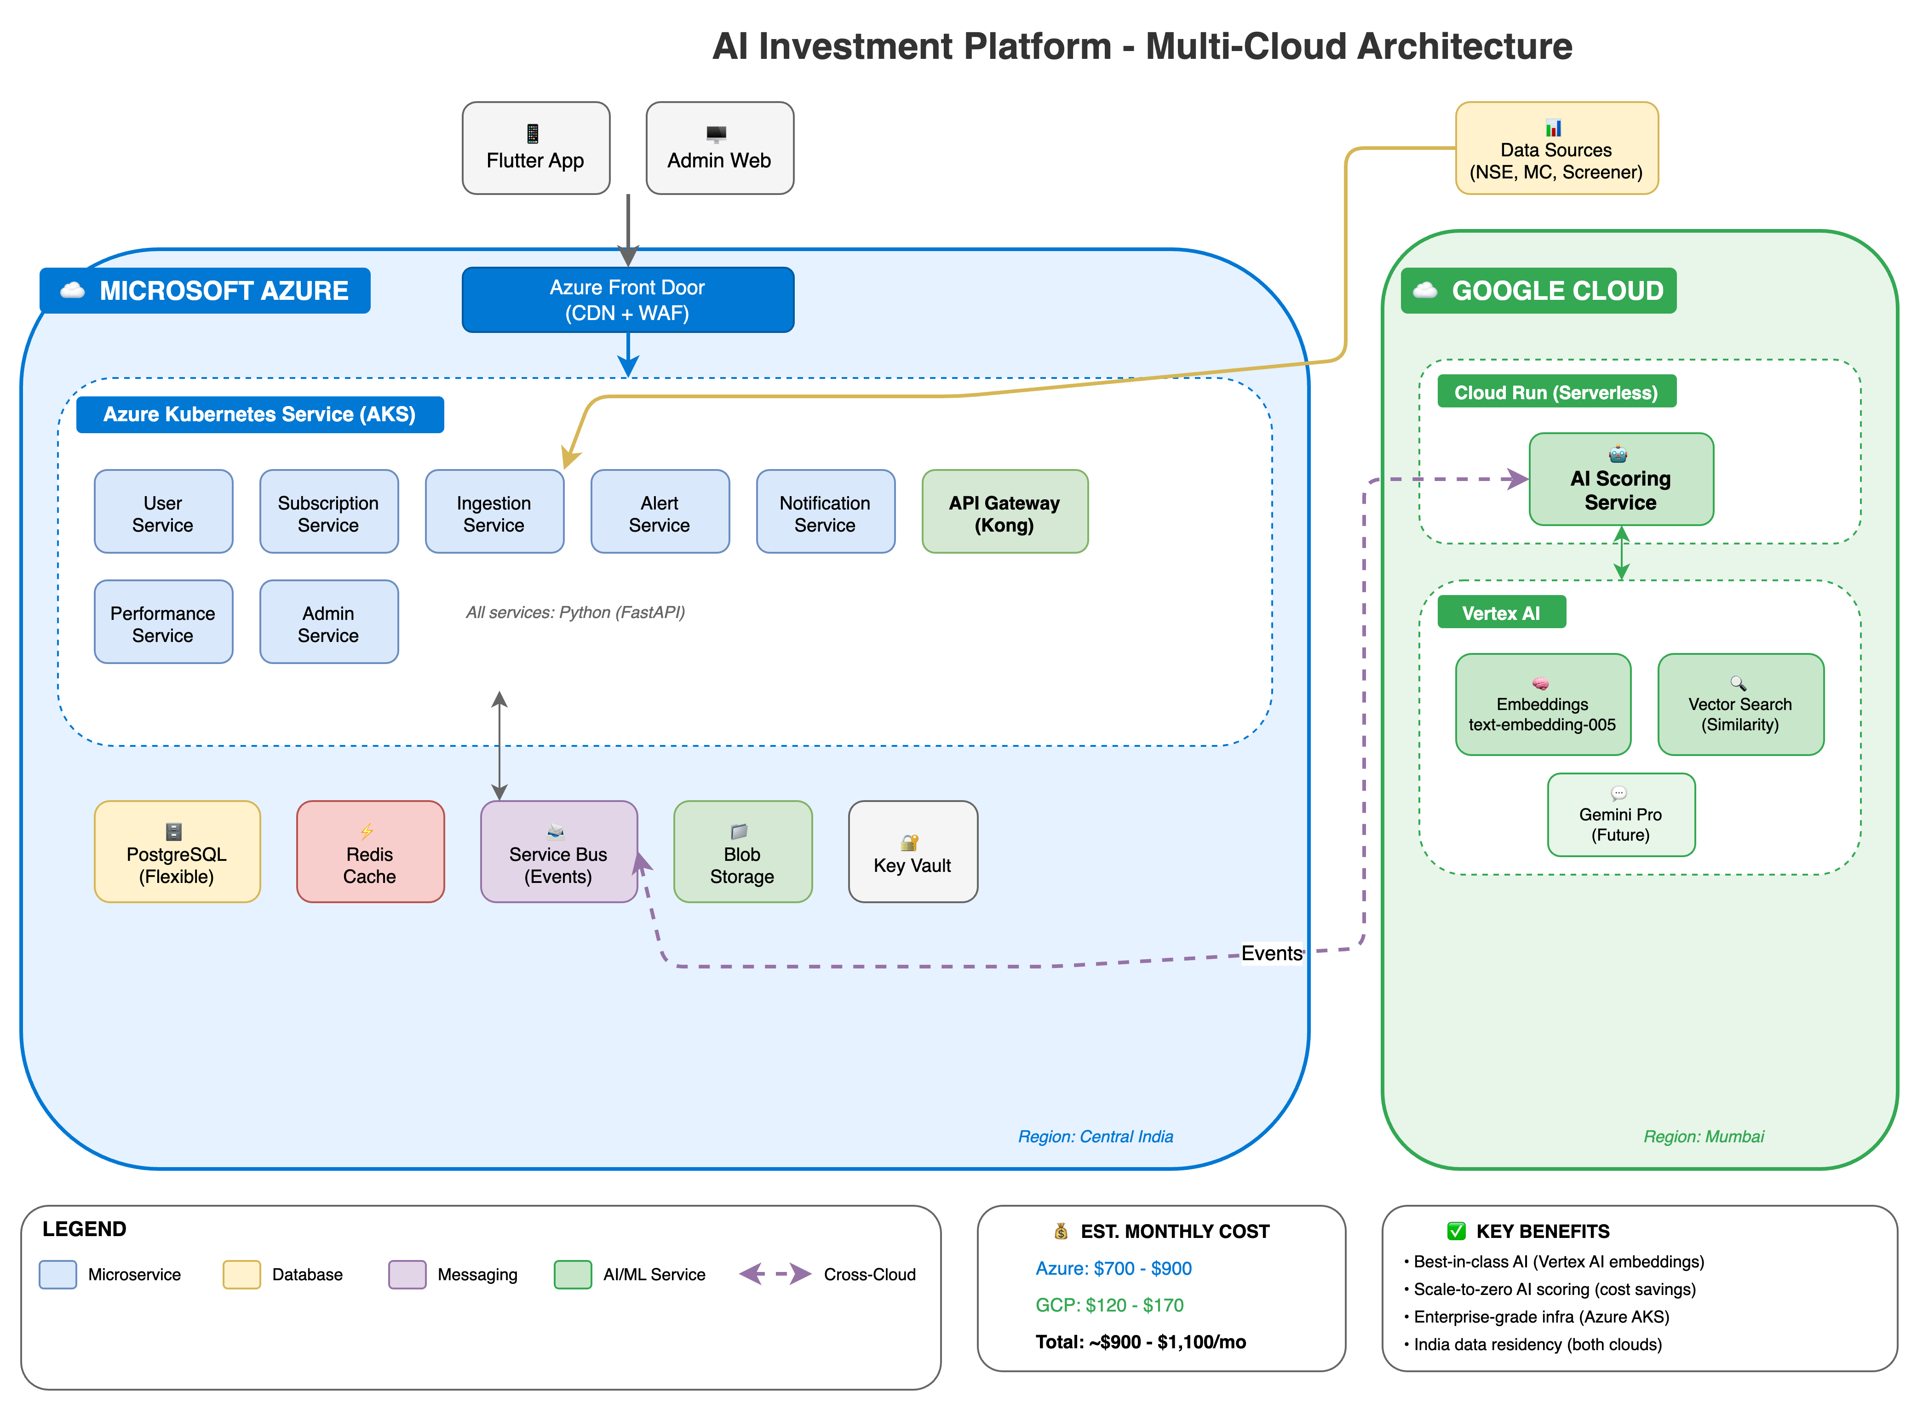

Slide 8
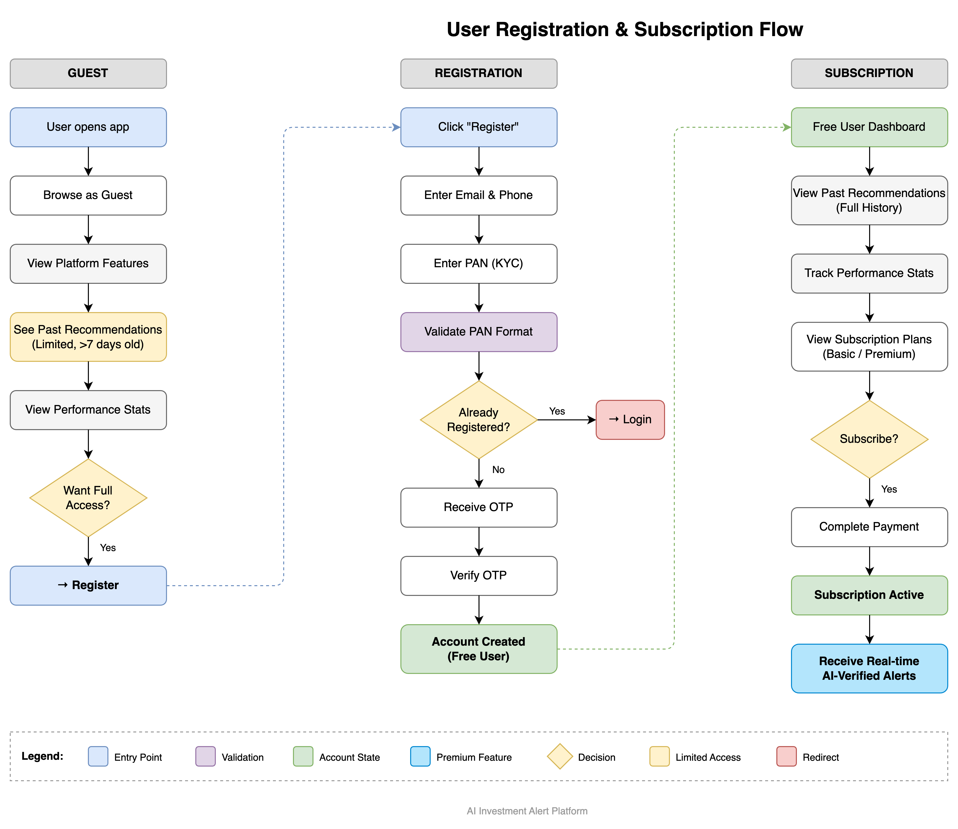

Slide 9
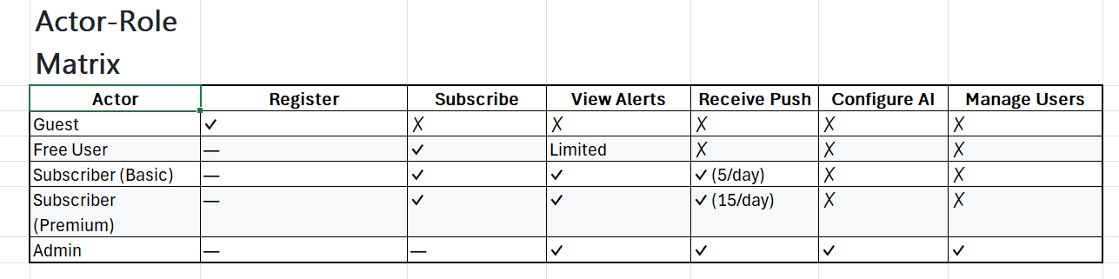
Actors & Roles

Slide 12
Thank you!

